Slide 1
NETWORK SOFTWARE
The first computer networks were designed with the hardware as the main concern and the software as an afterthought.
Network software is now highly structured.
Protocol Hierarchies
To reduce their design complexity, most networks are organized as a stack of layers or levels, each one built upon the one below it.
The number of layers, the name of each layer, the contents of each layer, and the function of each layer differ
from network to network.
When layer n on one machine carries on a conversation with layer n on another machine, the rules and conventions used in this conversation are collectively known as the layer n protocol.
Protocol is an agreement between the communicating parties on how communication is to proceed.

Slide 2
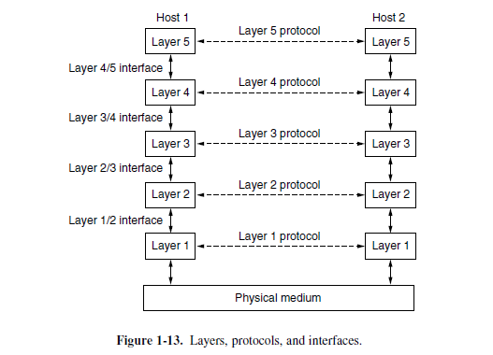
LAYERED ARCHITECTURE A five-layer network is illustrated in Fig. 1-13.

Slide 3
LAYERED ARCHITECTURE
The entities comprising the corresponding layers on different machines are called peers.
The peers may be software processes, hardware devices, or even human beings. In other words, it is the peers that communicate by using the protocol to talk to each other.
Each layer passes data and control information to the layer immediately below it, until the lowest layer is reached. Below layer 1 is the physical medium through which actual communication occurs. In
Fig. 1-13, virtual communication is shown by dotted lines and physical communication by solid lines.
Between each pair of adjacent layers is an interface. The interface defines which primitive operations and services the lower layer makes available to the upper one.
A set of layers and protocols is called a network architecture.
A list of the protocols used by a certain system, one protocol per layer, is called a protocol stack.

Slide 4
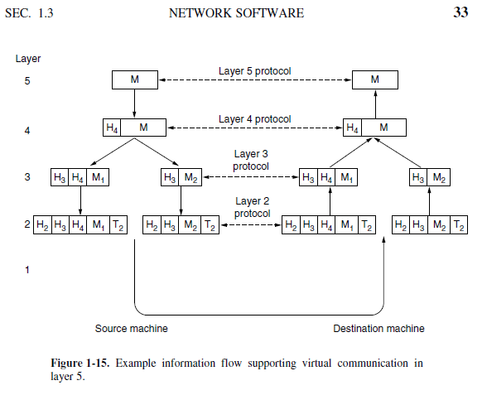
Message Passing with Headers

Slide 5
Design issues for the Layers
Reliability is the design issue of making a network that operates correctly even though it is made up of a collection of components that are themselves unreliable.
A second design issue concerns the evolution of the network. Over time, networks grow larger and new designs emerge that need to be connected to the existing network.
A third design issue is resource allocation. Networks provide a service to hosts from their underlying resources, such as the capacity of transmission lines.
The last major design issue is to secure the network by defending it against different kinds of threats.

Slide 6
Connection-Oriented Versus Connectionless Service
These are the two services given by the layers to layers above them. These services are:
Connection Oriented Service
Connectionless Services

Slide 7
Connection Oriented Services
There is a sequence of operation to be followed by the users of connection oriented service. These are:
Connection is established.
Information is sent.
Connection is released.
In connection oriented service we have to establish a connection before starting the communication. When connection is established, we send the message or the information and then we release the connection.
Connection oriented service is more reliable than connectionless service. We can send the message in connection oriented service if there is an error at the receivers end. Example of connection oriented is TCP (Transmission Control Protocol)

Slide 8
Connection Less Services
It is similar to the postal services, as it carries the full address where the message (letter) is to be carried. Each message is routed independently from source to destination. The order of message sent can be different from the order received.
In connectionless the data is transferred in one direction from source to destination without checking that destination is still there or not or if it prepared to accept the message. Authentication is not needed in this. Example of Connectionless service is UDP (User Datagram Protocol) protocol.

Slide 9
Difference: Connection oriented and Connectionless service
In connection oriented service authentication is needed, while connectionless service does not need any authentication.
Connection oriented protocol makes a connection and checks whether message is received or not and sends again if an error occurs, while connectionless service protocol does not guarantees a message delivery.
Connection oriented service is more reliable than connectionless service.
Connection oriented service interface is stream based and connectionless is message based.

Slide 10
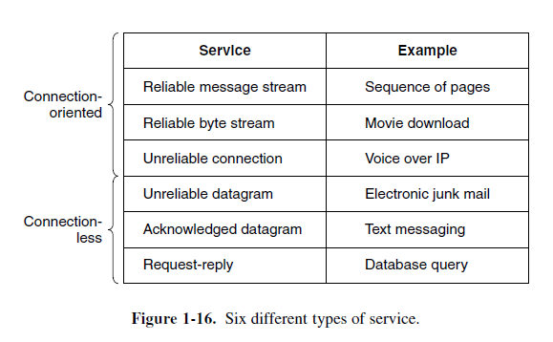
Figure 1-16 summarizes the types of services

Slide 11
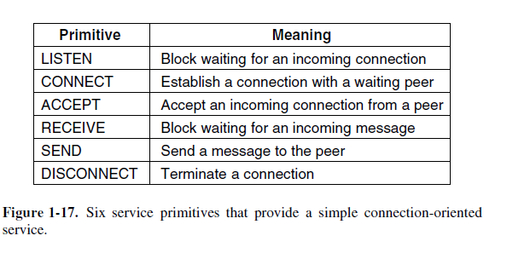
Service Primitives
A service is formally specified by a set of primitives (operations) available to user processes to access the service. These primitives tell the service to perform some action or report on an action taken by a peer entity.

Slide 12
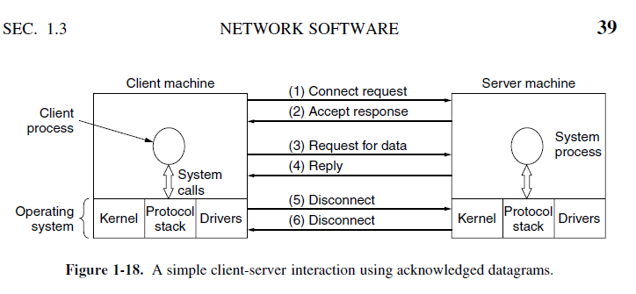

Slide 13
